Slide 1
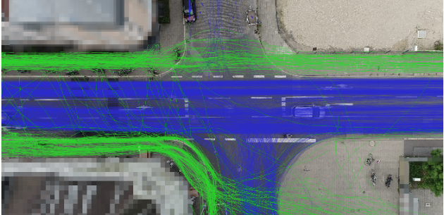




Pedestrian Crash Risk Assessment Based on Trajectory Using Bayesian Neural Network Researcher : Junhee Choi
What is the problem?
There are many incident values (e.g., sudden lane changes, crashes with pedestrians, lane closes due to disasters, etc.) in the urban traffic to adopt autonomous vehicles
Rare datasets make autonomous vehicles difficult to consider incident values Relieving an uncertain situation like a vehicle and pedestrian crash and pre-emptively react
Aim to develop a risk assessment based on vehicle and pedestrian trajectories using Bayesian Neural Network (BNN)
Why is this problem important?
In Korea, the number of accidents and fatalities are decreasing in recent seven years(2012-2019); however, the proportion of pedestrian fatalities is constant at forty percent, which is about two times than OECD average
Increasing personal mobility and planning a walkable city increase crash probability and various incident values
Access roads, bus stops, and the intersection where it is hard to find pedestrians using autonomous vehicle sensors need to use pre-risk assessment to relieving the incident situation by vehicle to infrastructure (V2I)
How can we solve this problem?
Pre-risk assessment can relieve collision vehicle and pedestrian
Risk field can be an efficient assessment criteria
Collecting trajectory data and predict their trajectory using Bayesian Neural Network
Proposed method results in probability field and evaluates overlapped risk field
trajectory data
prediction using BNN
BNN₁
$$\vec{y_{1}}$$
BNN₂
$$\vec{y_{2}}$$
● ● ●
BNN_{n-1}
$$\vec{y_{n−1}}$$
pedestrian trajectory
ego vehicle trajectory
BNN_{n}
$$\vec{y_{n}}$$
Bayesian layer
Flatten layer
Dense-Flipout layer
risk field
driver’s risk field
Uncertainty
pedestrian’s risk field
Certainty
What is key contribution?
Propose a risk assessment of vehicle-pedestrian in pre-crash situation
Propose a pedestrian risk field for risk assessment
Conduct an autonomous vehicle safety evaluation in the urban traffic network

